Slide 1
Strategy To increase the customer satisfaction Of an e-commerce company
Presented By: Ishita Arora
Last Updated: 20/02/2023

Slide 2
TABLE OF CONTENTS:
What Are We Talking About ?
Data Sources
Business Task
Findings
Conclusion
Recommendations
Appendix

Slide 3

What Are We Talking About ?
X&Y co
X&y co is the largest department store in Brazilian marketplaces. Olist connects small businesses from all over Brazil to channels without hassle and with a single contract. Those merchants are able to sell their products through the Store and ship them directly to the customers using x&y co logistics partners.
After a customer purchases the product from this Store, a seller gets notified to fulfill that order. Once the customer receives the product, or the estimated delivery date is due, the customer gets a satisfaction survey by email where he can give a note for the purchase experience and write down some comments.

Slide 4
Business task
To Identify
Important trends in the orders , payments , reviews and products data
To design effective ways for reducing time between estimated and actual delivery dates of products .
Gaining loyal customers by Improving communication betweeen customers , sellers and couriers , hence , establishing a trustworthy relationship with customers .

Slide 5

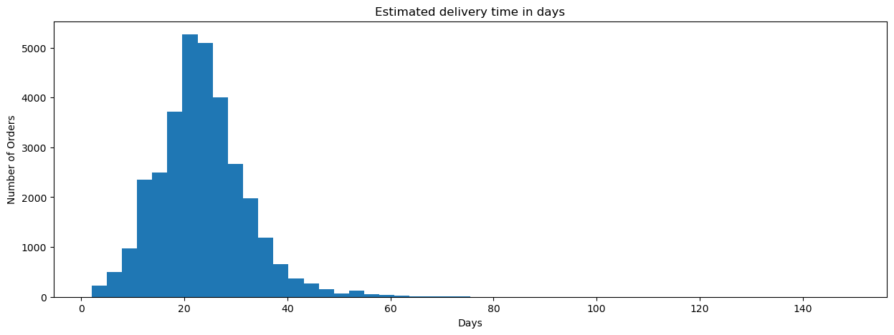
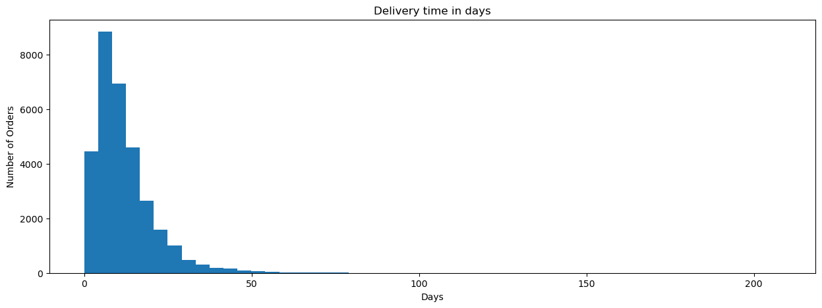
Findings
Here we can see that more than 5000 orders were estimated to be delivered well within 20 to 40 days .
whereas , a shown in the second visualisation , more than 4000 orders were delayed and more than 2000 orders took between 30 to 50 days .

Slide 6
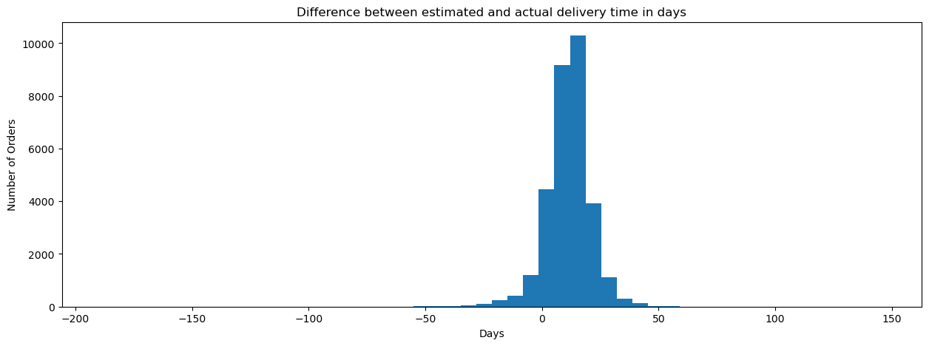

Slide 7
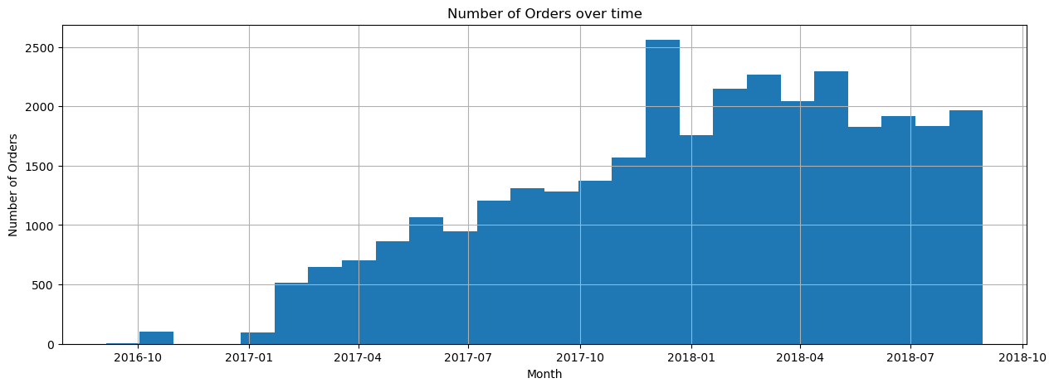
Possible reason for delay in deliveries
As we can see from the visual , the number of orders have significantly increased from january 2017 to july 2018 and beyond.
This might be a possible reason for delay in deliveries.

Slide 8
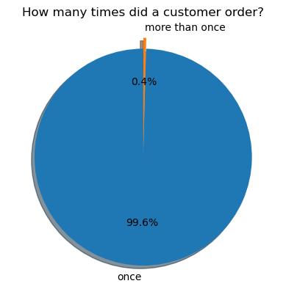
Percentage of loyal customers
From the visualisation , we can clearly see that :
more than 99% of customers order only once and only , less than 1% of customers order again.
Again , this suggests decreased customer satisfaction .

Slide 9
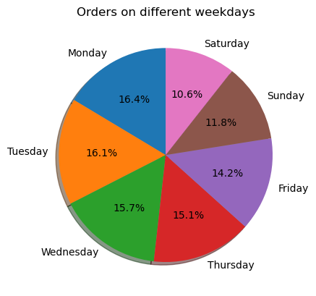
Percentage of total orders on each day of the week
From the visualisation , we can clearly see that
Mondays and Tuesdays are the most buisiest days of the week , receiving more than 16% of the total orders .
Weekends are the less hectic ones , receiving 10-11% of all the orders.

Slide 10
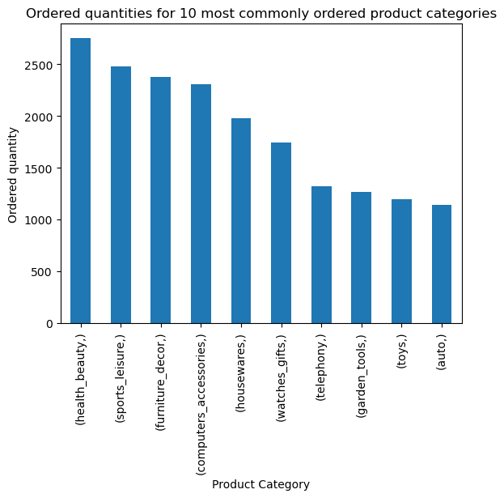
Top products
From the visualisation , we can clearly see that
health_beauty , sports_leisure items and furniture_Decor are the top three most ordered items.

Slide 11
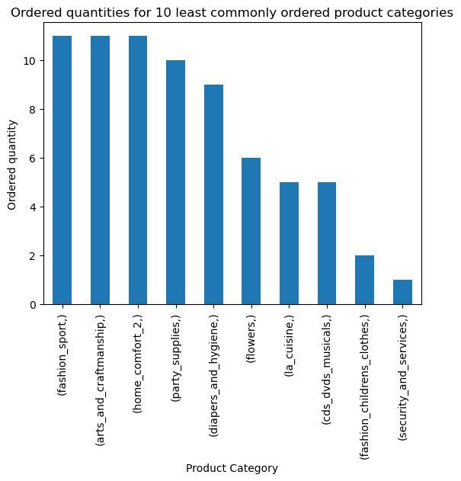
Least ordered products
The items of the category 'children's clothes', 'cds/dvds/musicals' and 'security and services' are the lease ordered items in this exact order.
.

Slide 12
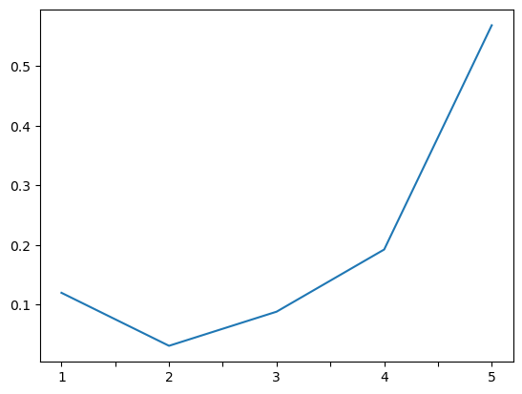
Review scores
Maximum number of products have a review score between 4 to 5
This suggests that the issue might not have mostly been with the quality of the product itself.

Slide 13
Conclusion
Health_beauty , sports_leisure items and furniture_decor are the top three most ordered items.
The items of the category 'children's clothes', 'cds/dvds/musicals' and ‘security and services' are the lease ordered items in this exact order.
More than 99% of customers order only once and only , less than 1% of customers order again.
Monday is the buisiest day of the week , receiving 16.4% of the total orders .
more than 70% of customers use credit_card as their payment method with less than 2% of them using debit card , thus , being the least preferred payment method.
More than 000 customers have a delivery time of more than 20 days.

Slide 14
Recommendations
The data on the monthly or yearly sales of each of these items can be collected to further identify , which of these items are actually more profitable for the company .
The top and the least profitable products can be identified and accordingly, the promotional strategies can be designed to escalate a product's sales , or to discontinue a product altogether , as per the requirement.
Individual states can be studied in terms of sales of each product done in those states , so as to adjust the manufacturing in those areas accordingly.
Regularly monitor and analyze customer reviews to gain insights in product quality and identify areas for improvement.
Investigate delivery delays and undelivered orders. Analyzing geographic locations could bring insights about certain challenges with demographics, accessibility, and possible route optimization.
Providing a proper shipment tracking system , having clear and concise communication between customers, sellers and couriers.
Regular updates can set proper expectations among customers and specific delivery instructions of customers can be properly accommodated.

Slide 15
Appendix
Additional links
Data source
Website
Jupyter notebook

Slide 16
Thank You
For Watching

